Slide 1
INTERNET PROGRAMMING AND MOBILE PROGRAMMING
GROUP 13
INTERNET PROGRAMMING AND MOBILE PROGRAMMING
Dr Valery
Dr Valery
Dr Valery

Slide 2
REQUIERMENT GATHERING
The Biometric Student's Attendance Mobile Application is designed to streamline attendance tracking in academic settings.

Slide 3
REQUIREMENT GATHERING
USER REQUIREMENT
SYSTEM REQUIREMENT
BUSINESS REQUIREMENT
.
System requirements refer to the technical specifications and constraints that a technology or system must meet in order to function properly.
Business requirements refer to the high-level goals and objectives that an organization wants to achieve through the use of a technology or system.
User requirements refer to the goals and needs that a user has for a technology or system.
User requirements refer to the goals and needs that a user has for a technology or system.

Slide 4
USER REQUIREMENT
.
DATA SYNCHRONISATION
ATTENDANCE TRACKING AND REPORTING
USER MANAGEMENT

Slide 5
FUNCTIONAL REQUIREMENTS
User Management
Biometric Authentication
Attendance Tracking and Reports

Slide 6

Non Functional requirements
Performance
Scalability
Offline functionality

Slide 7
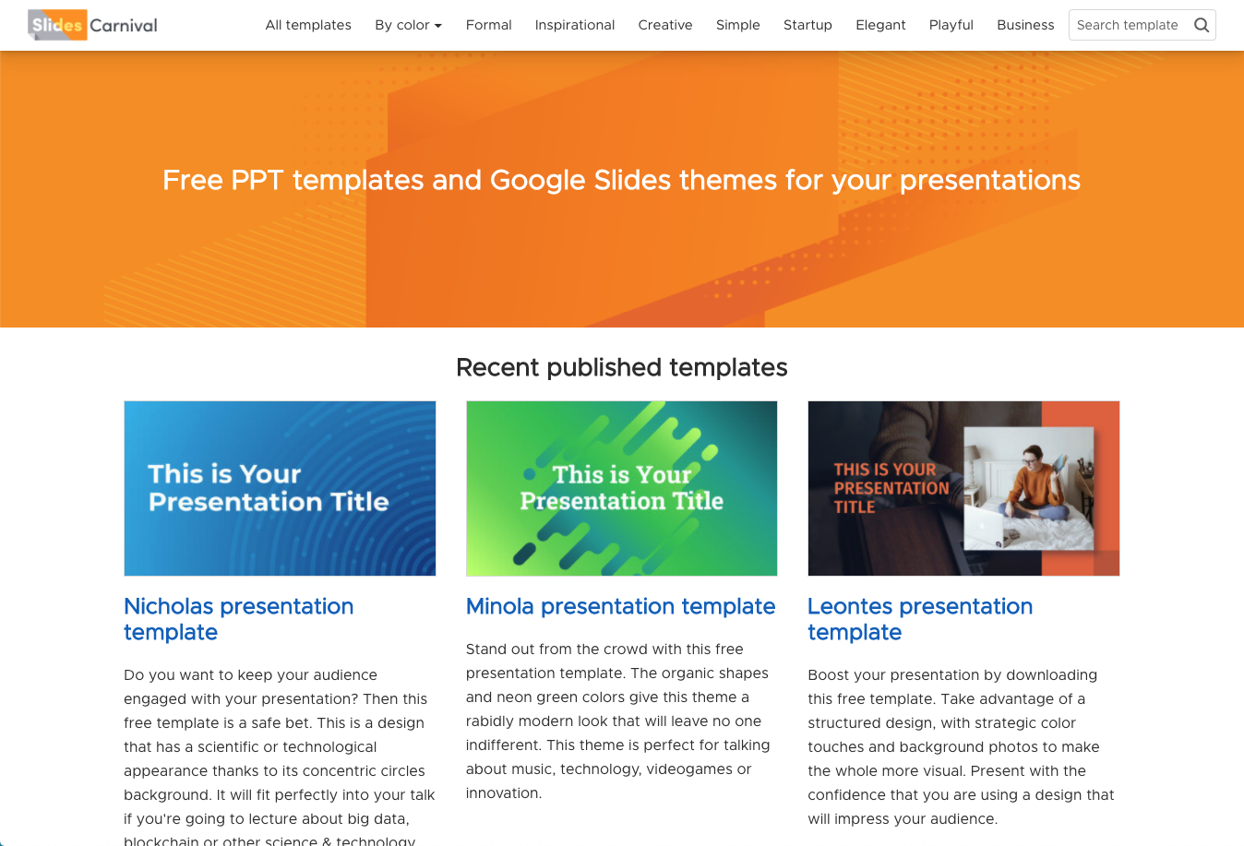
BUSINESS REQUIREMENT

Slide 8

BUSINESS REQUIREMENT
IMPROVE ATTENDANCE MANAGEMENT
Increase instructor productivity
BUSINESS REQUIREMENT
IMPROVE ATTENDANCE MANAGEMENT
Increase instructor productivity

Slide 9
THANK YOU

